Slide 1
The Visual Rhetorical Analysis

Slide 2
Visual Rhetorical Analysis Requirements
Build your Sanctuary
Make a video for sanctuary
Upload video to Behance and share world in Drive Folder
Switch with partner
Write analysis based off video and/or world
750 – 1000 words
Use images
Argue a main point
Use bold, italics, and different fonts/colors to get point across

Slide 3
Visual vs Textual Analysis
Analyzing visual texts is both similar to and different from analyzing verbal texts:
In both cases, you consider the text’s rhetorical situation, which is made up of its audience, purpose, and context (or circumstances).
In both cases, you think about how the text’s elements communicate for that audience, purpose, and context.
But, in visual text, you focus primarily on visual elements instead of verbal.

Slide 4
Analyzing from a Rhetorical Situation
Who is the intended audience?
What is its purpose? In other words, why was this made and why in this way?
What is its context or environment? In other words, where, when, and how would you come across this structure?

Slide 5
The Rhetorical Situation
Purpose – What is this video/structure representing. Why is it here? Why was it built in this way?
Audience – Who is the intended audience? Who would pick up on the cues from the video?
Stance – What does the structure say about the villain? What are the author’s thoughts on the villain?
Context – What is the environment? Does the structure/video and associated techniques fit the structure?
Genre – Did the video represent the structure well? How does the video compare to the world?

Slide 6
Other things to consider
Tone
Arrangement
Location
Scale
Text
Color
Readability/Detail
For elaboration: https://writingcommons.org/breaking-down-an-image

Slide 7
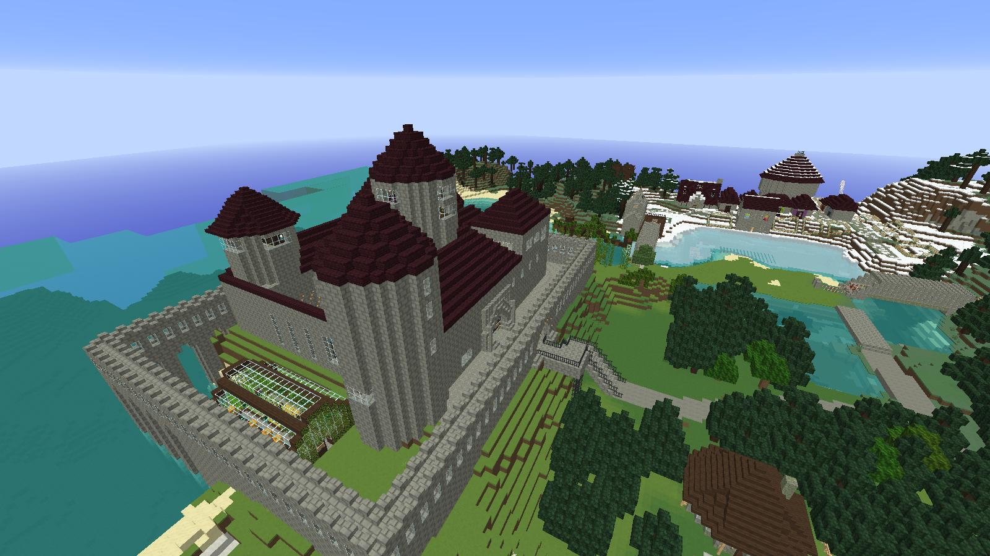

Slide 8
